Slide 1
IBM University Engagement Project Submission
“Exploring the Power of Agentic AI with IBM Granite and LangFlow”

Slide 2

Project Tile – AI-Powered Travel Planner Agent using IBM Granite and watsonx.ai
Domain of Project – Travel & Tourism
Student Name | Recent Passport Photo | Email ID | Mobile number [WhatsApp]
Bhavya Gupta |  | bhavya.gupta1017@gmail.com | 8810991990

Slide 3
Problem Statement – Travel Planner Agent
The Challenge
Planning a trip involves multiple tasks such as choosing destinations, finding transportation, selecting hotels, estimating budgets, checking weather conditions, and creating a day-wise itinerary. Users often spend hours searching across different websites, making the process time-consuming and confusing. Traditional travel planning lacks personalization based on user preferences, budget, and travel interests.
The Objective
Develop an AI-powered Travel Planner Agent using IBM watsonx.ai and Granite Models that generates personalized travel plans based on user preferences. The system should:
Recommend destinations and attractions
Suggest transportation options
Recommend hotels based on budget
Generate day-wise travel itineraries
Provide budget estimation
Suggest local food recommendations
Give packing tips and safety guidelines
Deliver personalized travel experiences

Slide 4
Proposed Solution -
The proposed solution is an AI-powered Travel Planner Agent developed using IBM watsonx.ai, IBM Granite 4, Flask, HTML, CSS, and JavaScript.
The application collects user information such as:
Source city and Destination
Budget
Number of travel days and Number of travellers
Preferred transport
Hotel type and Travel interests
Using IBM Granite, the system analyzes the user's requirements and generates a personalized travel itinerary that includes:
Trip overview
Recommended transport and Hotel suggestions
Day-wise itinerary
Tourist attractions and Famous local foods
Budget breakdown
Packing checklist and Safety tips
The AI agent provides intelligent recommendations within seconds, reducing manual planning effort and improving travel experiences.

Slide 5
Technology Used
1) User Input Form:- Collects travel details like destination, budget, duration, transport, hotel, and preferences.
2) IBM watsonx.ai Runtime :- Processes user requests and connects with the IBM Granite model.
3) IBM Granite-4-H-Small :- Generates personalized travel itineraries and recommendations.
4) Prompt Engineering :- Converts user input into a structured AI prompt.
5) Flask Backend :- Handles requests, communicates with IBM watsonx.ai, and returns AI responses.
IBM Cloud – It provides the infrastructure to build, deploy, and scale the Nutrition Agent efficiently. IBM Cloud enables a reliable, secure, and scalable environment for deploying the Nutrition Agent.
6) HTML, CSS & JavaScript :- Creates an interactive and responsive user interface.
7) JSON Response Handler :- Transfers data between the frontend and backend efficiently.

Slide 6
component Used -
1) User Input Form:- Collects travel details such as source city, destination, budget, number of days, travellers, transport preference, hotel type, and travel interests.
2) IBM watsonx.ai Runtime :- Processes user requests and securely communicates with the IBM Granite foundation model.
3) IBM Granite-4-H-Small Model :- Generates personalized travel itineraries, transport suggestions, hotel recommendations, budget estimates, and travel advice using natural language reasoning.
4) Prompt Engineering :- Converts user travel preferences into a structured prompt that guides the AI model to generate accurate and personalized travel plans.
5) Flask Backend :- Handles user requests, communicates with IBM watsonx.ai Runtime, processes AI responses, and returns the generated itinerary to the frontend.
6) HTML, CSS & JavaScript Frontend :- Provides an interactive and user-friendly interface where users enter travel details and view the AI-generated itinerary.
7) JSON Response Handler :- Transfers travel data between the frontend and backend in JSON format, ensuring smooth communication and fast response generation.

Slide 7
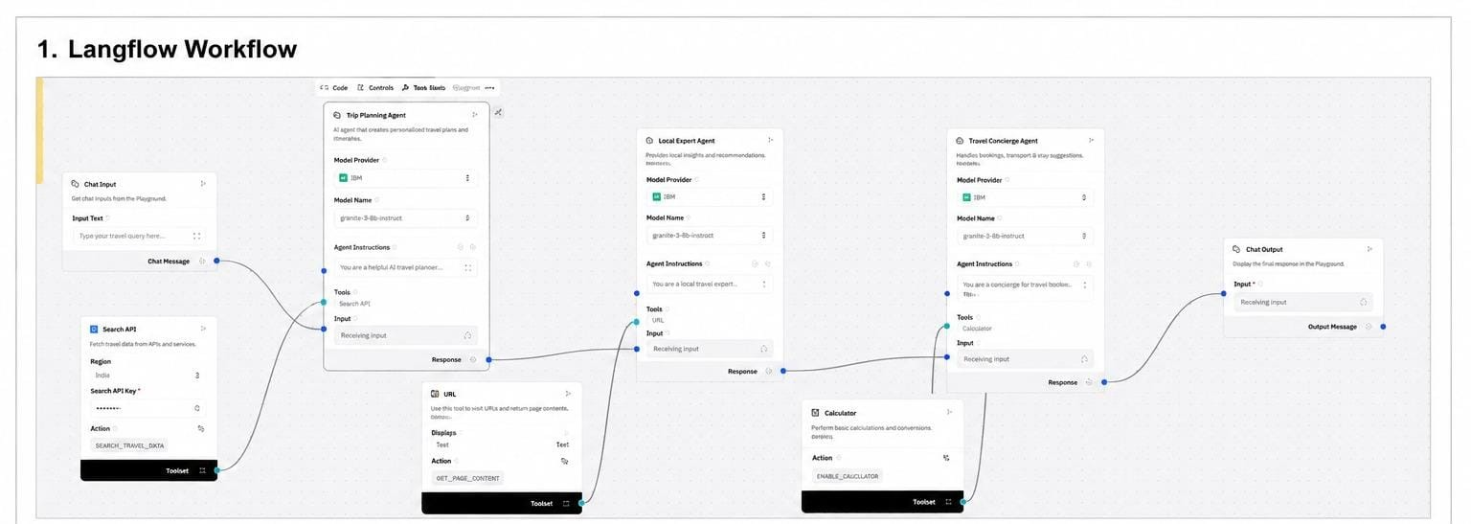

Slide 8
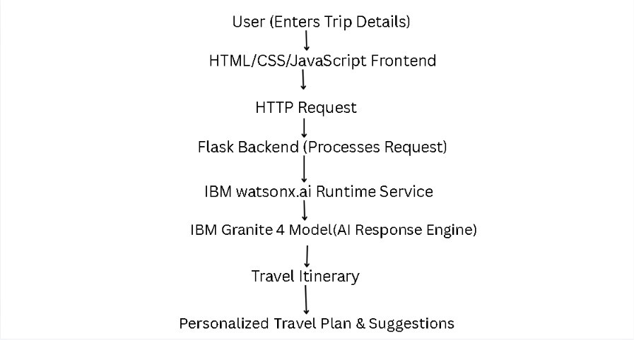
Architecture blueprint

Slide 9

Role of Agentic AI in the solution
Agentic AI enables the Travel Planner Agent to function as an intelligent, autonomous travel assistant rather than a simple chatbot. Using IBM watsonx.ai and IBM Granite 4 models, it analyzes user preferences and generates personalized travel recommendations.
The AI agent understands important travel details such as source city, destination, budget, travel duration, transportation preference, hotel type, and travel interests to create customized travel itineraries. It intelligently recommends the best transportation options, suitable accommodations, famous tourist attractions, local cuisine, and estimated travel expenses.
Agentic AI brings context awareness, enabling the system to generate recommendations that match each user's specific requirements and travel goals. It also provides dynamic itinerary planning, organizing activities into a structured day-wise schedule for a smooth travel experience.
Overall, Agentic AI makes the Travel Planner Agent proactive, personalized, and goal-driven, acting as a smart digital travel assistant that simplifies travel planning and provides an enjoyable, hassle-free experience.

Slide 10
Novelty and Uniqueness
The proposed Travel Planner Agent combines Agentic AI, IBM watsonx.ai, and IBM Granite 4 to deliver intelligent and personalized travel planning.
AI-Powered Personalization – Generates customized travel itineraries based on user preferences, budget, destination, and travel duration.
Context-Aware Recommendations – Suggests suitable hotels, transport options, tourist attractions, and local experiences.
Smart Itinerary Generation – Creates detailed day-wise travel plans with budget estimation and travel tips.
IBM Granite Integration – Uses IBM Granite foundation models to provide accurate, natural, and human-like travel recommendations.
Scalable & User-Friendly Solution – Built using Flask and IBM watsonx.ai, making the application lightweight, interactive, and easy to use.

Slide 11
Git Hub Link
Github URL – https://github.com/BhavyaGupta1017/Travel-Planner
This github repository contains :
Problem statement pdf
Presentation
App.json file
All the screenshots of the project
The static and template files required
·
·
·

Slide 12
Future Scope
1. Integration with Real-Time Travel Services –The Travel Planner Agent can be integrated with live weather, flight, hotel, and transportation APIs to provide real-time travel information. This will enable users to receive up-to-date recommendations, price comparisons, weather forecasts, and travel alerts, making trip planning more accurate and reliable.
2. AI-Powered Voice Assistant & Multilingual Support –The system can be enhanced with a voice-enabled assistant and support for multiple languages, allowing users to interact naturally in their preferred language. This will improve accessibility, provide a better user experience, and make the Travel Planner Agent suitable for a wider range of travelers.
3. Smart Booking & Interactive Maps – Future versions can integrate Google Maps and online booking services to help users navigate destinations, explore nearby attractions, and book flights or hotels directly from the application, creating a complete end-to-end travel planning solution.
·
·
·

Slide 13
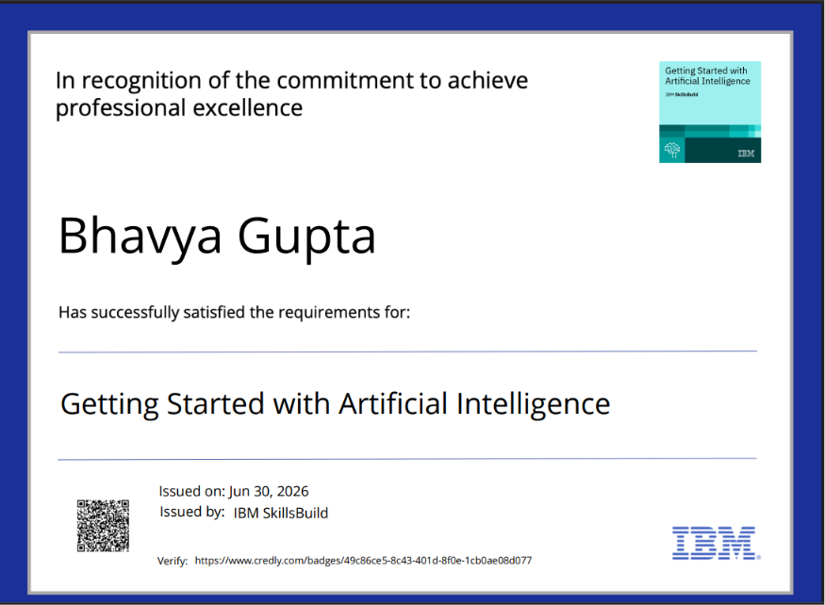

Certificates Earned:

Slide 14
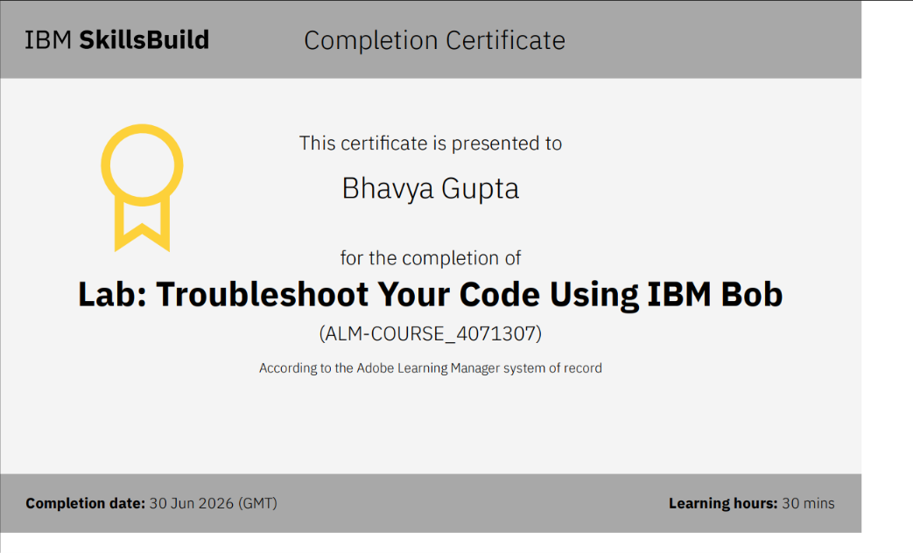
Certificates Earned:​

Slide 15


